Slide 1
Software Engineering and Architecture
Energy Efficiency
An important Quality Attribute

Slide 2

Motivation
Well… Large and important topic !
I will delimit myself to energy-efficiency
… or
Ala: Patient Inger’s blood-pressure is uploaded to server
  Architecture A spends 3.1mJ; Architecture B spends 6.7mJ
  We prefer architecture A, right?
Notes:
Source: https://www.ibm.com/cloud/blog/green-computing

Slide 3
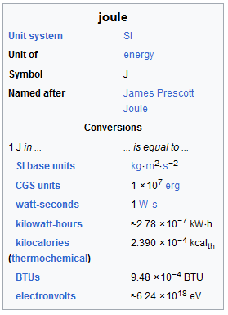
Energy and Power
We are basically interested in energy
  Energy = Amount of work
Energy is measured in Joule (SI unit)
    1J work is done when a force of 1 newton
    displaces a mass 1 meter
      Newton = force accelerating 1kg by 1m/s^2
Power is measured in Watt
  Power = energy / second; 1 W = 1 J/s
    Or…
  1 Joule is 1 W in 1 second = 1 Ws
  1 KWh = 3.6 MJ
100g Hellmann’s Mayonnaise contains 2,965,000 J (0.82 kWh)
About 35 min sweaty bicycling…

Slide 4
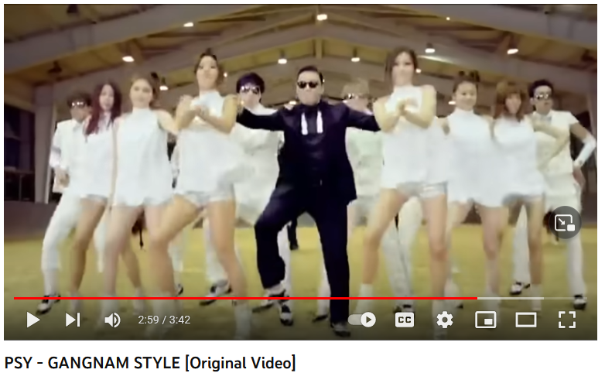

Motivating Example
Gangnam Style
  Was shown 1.7 x 10^9 times
  the first year
  Energy to stream once is
  0.19kWh
  Total: 312 GWh
  Danish average house (“parcelhus”) yearly electricity consumption
    4.4 – 5.0 MWh
  ~ 70.000 Danish houses
Morale: None…
But it is a bit thought provoking…
Notes:
Source: https://www.sciencedirect.com/science/article/abs/pii/S0164121216000777;
https://www.ok.dk/privat/hjaelp/el/elforbrug/hvad-er-et-typisk-aarsforbrug-af-el

Slide 5
Energy = Work Done
Hardware spends energy, because our Software wants work to be done.

Slide 6
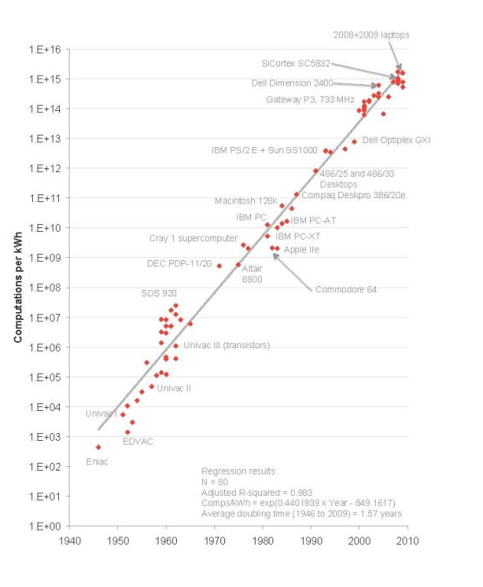
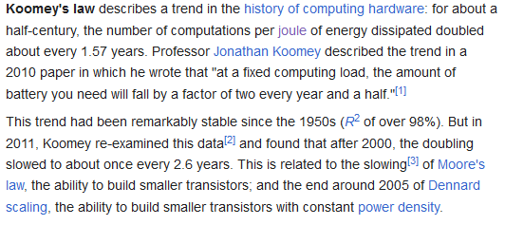
Koomey’s Law
Hardware consumes energy
  But is improving all the time!
    They are the good guys!
  The curve is flattening though…
Notes:
https://en.wikipedia.org/wiki/Koomey%27s_law

Slide 7
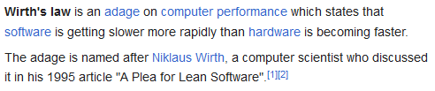
Wirth’s Law
Unfortunately, we as developers and architects are terrible at writing software or writing too much ☹
  We are the bad guys!
Example:
  A ‘small’ linux desktop: Lubuntu
  First used in 2016, easily ran in a 2GB RAM VM ☺
  Last 24.04 version, has issues running in a 4GB RAM VM ☹
  No real perceived benefits! But 3.4 times larger…
Notes:
https://en.wikipedia.org/wiki/Wirth's_law

Slide 8
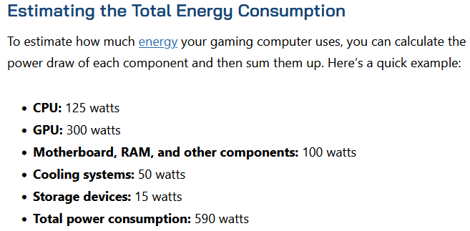
What is Power used for?
Note
  CPU drives much
  else
    Heat/fan to
    cool when
    high load
  Note
    SSD+DRAM
    is ‘cheap’
    power wise…
275W
15W (~5%)
Out-of-box: Network.
Devices: Display, Sensors (GPS, accelerometer, sound, …)
Notes:
Kempen et al (2024) finds 2-8% of energy is by RAM.
https://computerinfobits.com/how-much-energy-do-gaming-computers-use/
Other source:
https://www.buildcomputers.net/pc-power-requirements.html.

Slide 9
What is Power used for?
Note
  CPU drives much
  else
    Heat/fan to
    cool when
    high load
  Note
    SSD+DRAM
    is ‘cheap’
    power wise…
275W
The Apollo 13 Team returned safely to earth, but was heavily water rationed during their perilous return flight – because they needed the water to cool the guidance computer!
15W (~5%)
Out-of-box: Network.
Devices: Display, Sensors (GPS, accelerometer, sound, …)
Notes:
Kempen et al (2024) finds 2-8% of energy is by RAM.
https://computerinfobits.com/how-much-energy-do-gaming-computers-use/
Other source:
https://www.buildcomputers.net/pc-power-requirements.html.

Slide 10
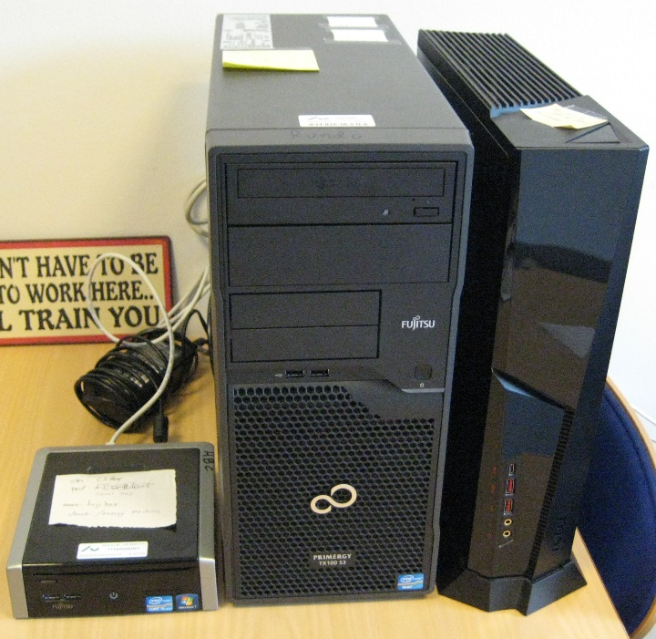
Examples: My Starting Lab
The Lab
  Fujitsu Esprimo Q900 (2012)
  MSI Trident (2020)
Installed with Ubuntu 22.04 LTS
  Headless
    No use for the GeForce RTX™ 2080 Ti ☺
Idle Power Consumption
  Esprimo: ~ 11 W (plug) / 2.8 W (CPU)
  MSI: ~ 40 W (plug) / 7.4 W (CPU)
    At ~95% CPU load@Plug: Esprimo 43W and MSI 160W
Notes:
Full throttle: Esprimo ~43W, MSI ~160-120W

Slide 11
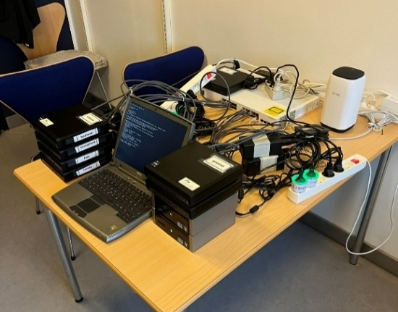
For Workshops
For teaching
Still rather
Storm P like ☺

Slide 12
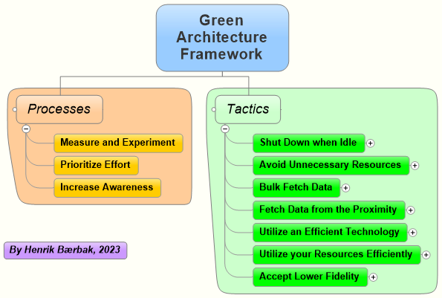
The Framework
The Green Architecture framework ☺
https://baerbak.cs.au.dk/papers/gaf.html

Slide 13
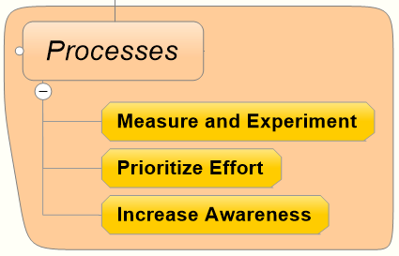
Processes
How we design Green Architectures?

Slide 14
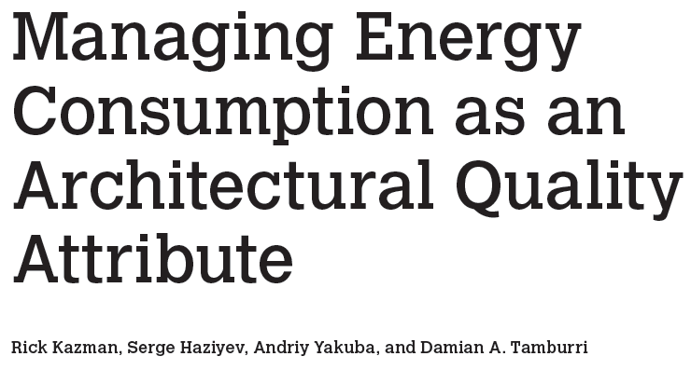

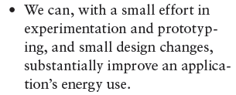
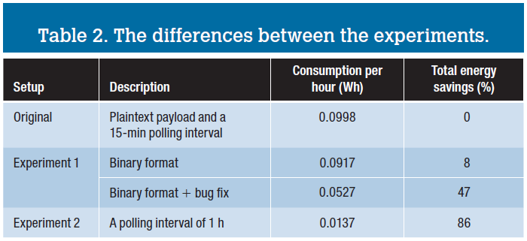
Measure and Experiment
You need to measure!
You need to experiment!

Slide 15
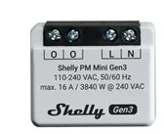
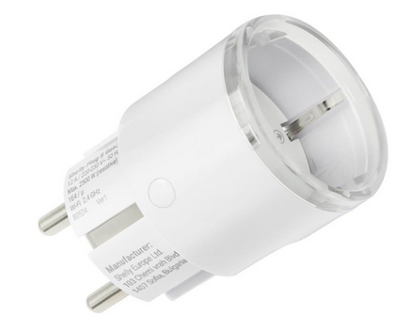
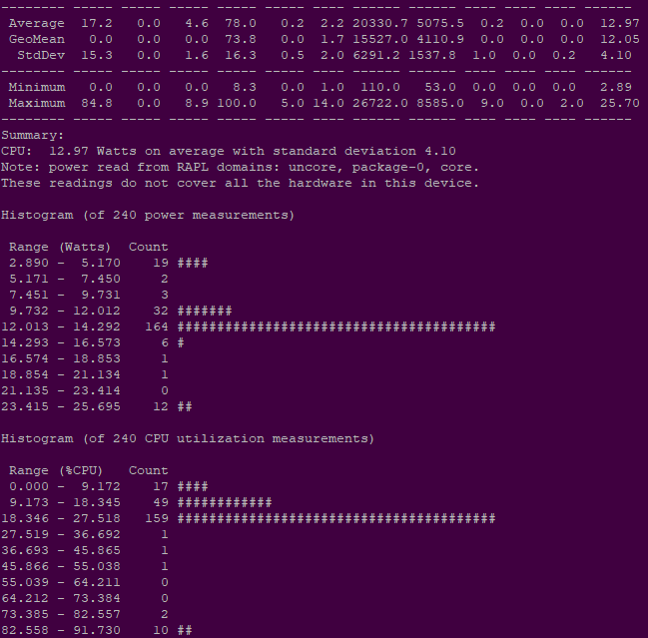
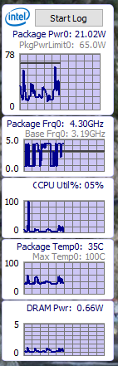
Measurements
Options
  Measure wall power
    Get going for ~100kr
  Measure on-chip power
    RAPL: Running Average Power Limit
    powerstat (linux)
    power gadget (windows)

Slide 16
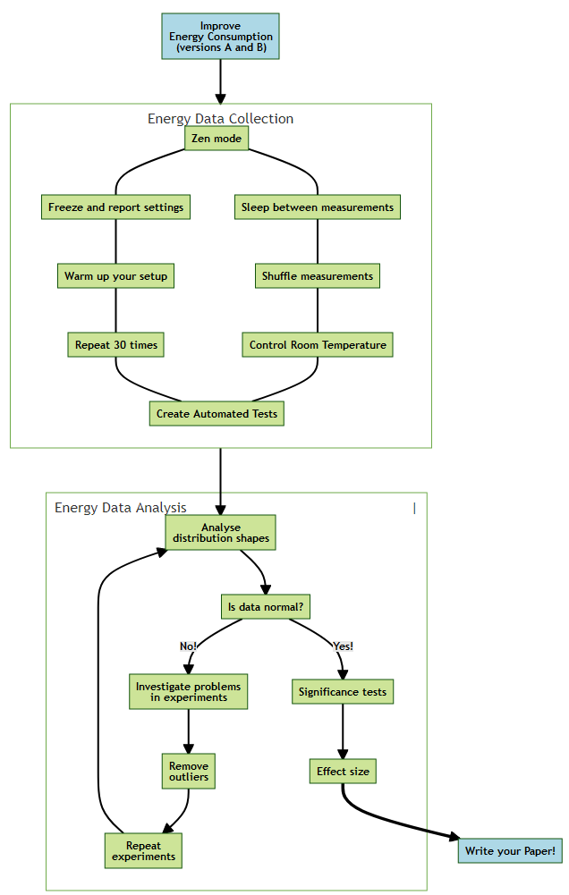
Be Systematic
As in Physics
  Control the environment, reduce error
  sources
  Make many experiments, large sample size
  Use proper statistical methods
Luiz Cruz (2021)
  https://luiscruz.github.io/2021/10/10/scientific-guide.html

Slide 17
Prioritize Effort
Prioritize Effort
  Know the usage profile
    (by measurements ☺)
  And invest your effort where
  it counts
    Those user stories that
    are executed the most and
    that can be optimized the
    most – are the ones to
    spend your effort on optimizing
      Sounds reasonable, but you need to know the usage profile ☺

Slide 18
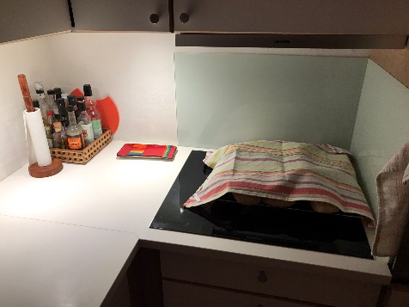
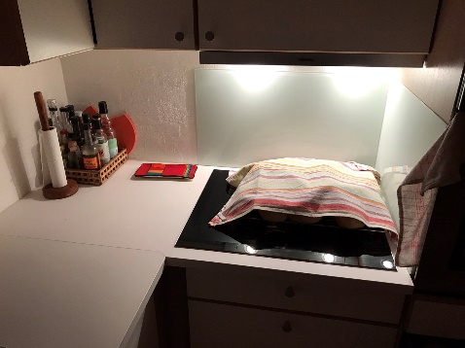
Increase Awareness
Increase Awareness
  All architects/developers/
  stakeholders informed
  about how to increase
  energy-efficiency
From my kitchen. Which one is 2W and which 40W?
  You have to tell the kids which one to prefer ☺

Slide 19
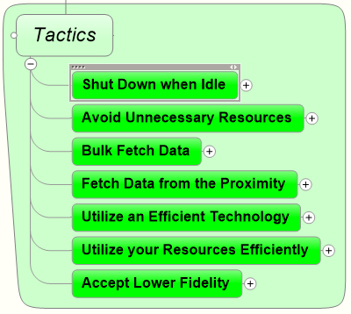
Tactics
How do we then do
Green Architecting?

Slide 20
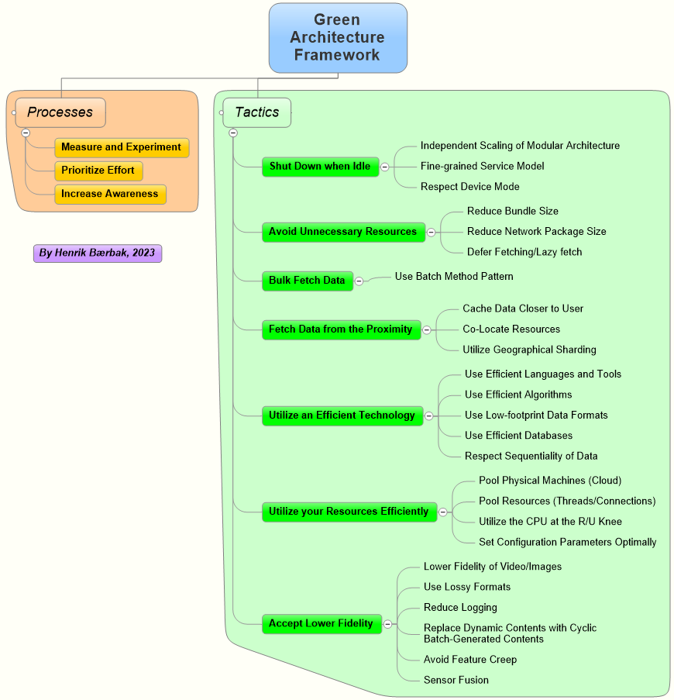
Set of tactics
  Architectural design
  decision to impact
  energy-efficiency
Quite a lot of tactics under
seven main categories
  Some of which are a bit “above your
  current pay-grade” ☺
SWEA picks follows…

Slide 21
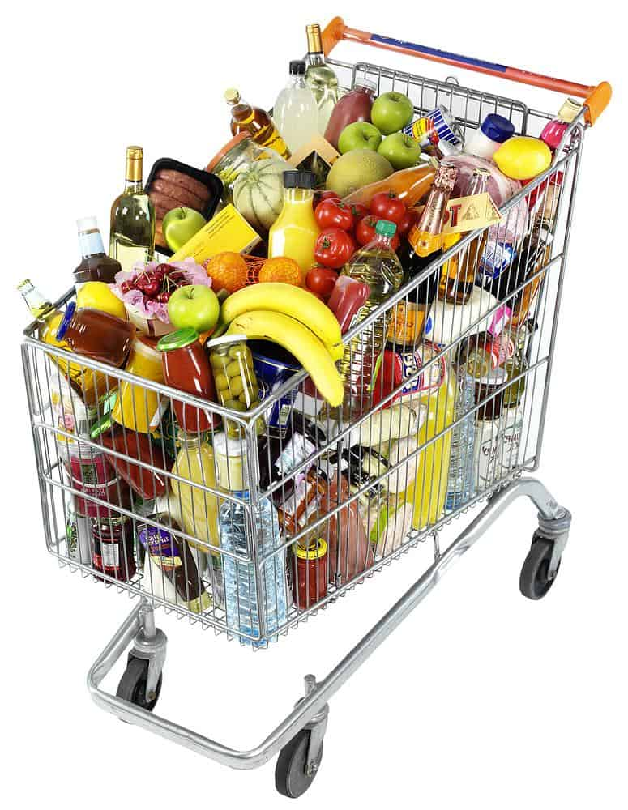
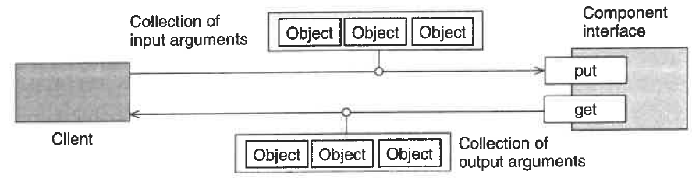
Bulk Fetch Data
“Buy 50 things at the super market once, instead of making 50 trips buying a single thing”
  POSA4(2007): Batch Method
    Iterator pattern is an energy anti pattern
      getNext() across the network is a chatty interface
      Use pagination instead – bulk fetch next 50 items in one chunk
Notes:
Source: Patterns of Software Architecture Vol 4 / Buschmann et al.

Slide 22
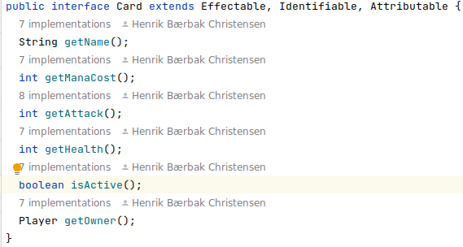
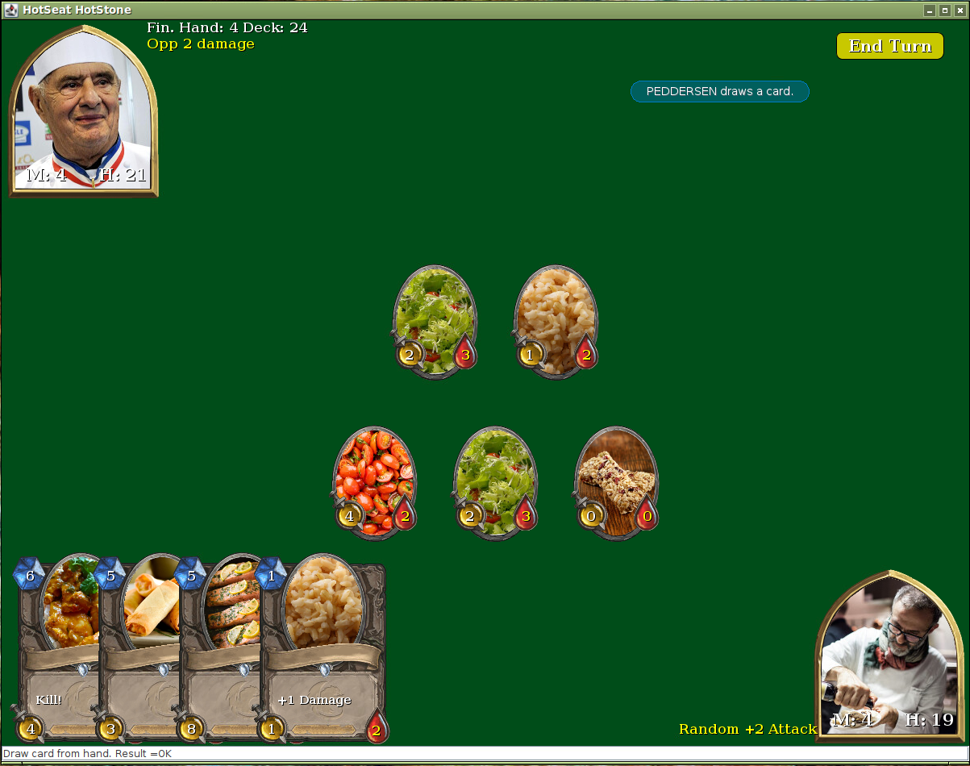
Bulk Fetch Data
“Buy 50 things at the super market once, instead of making 50 trips buying a single thing”
Example
  Classic OO is often a very fine-grained API
The UI needs to get all card data from the server when redrawing UI…
Notes:
Source: Patterns of Software Architecture Vol 4 / Buschmann et al.

Slide 23
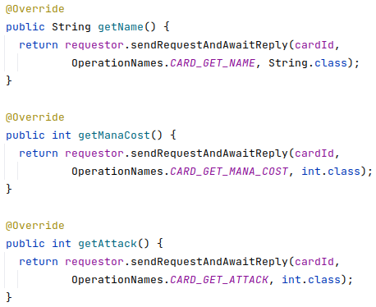
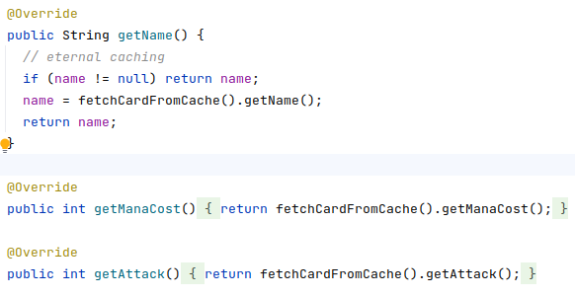
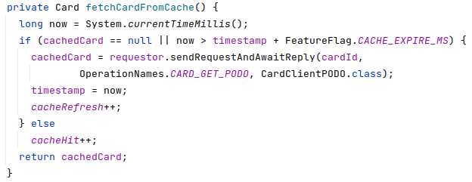
Example of A/B Architecture
The Card interface
  Two remote implementations
Broker pattern
Classic (RMI-like)
Broker pattern
Batch Method
a) Cache 5 secs b) Get PODO

Slide 24
Bulk Fetch Data
“Buy 50 things at the super market once, instead of making 50 trips buying a single thing”
Comparison
  Classic Broker (the one you make)
    5.66W (σ 0.90W)
  Batch Method Broker (using caching)
    4.12W (σ 0.79W)
    (Reducing number of network calls to 43%)
  Saving 27% energy
    And this is on the server side only!
Notes:
Source: Patterns of Software Architecture Vol 4 / Buschmann et al.

Slide 25
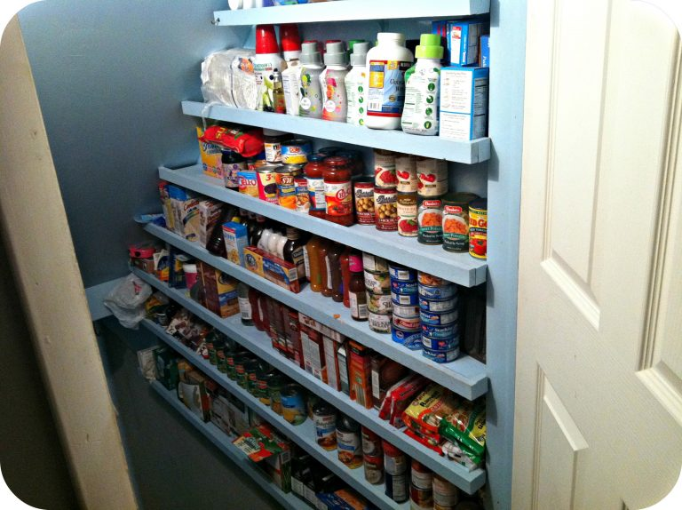
Fetch Data from the Proximity
“Have a stock of supplies to avoid a lot of trips to the super market”
Cache Data Closer to User
  The Batch Method Broker is one such
  example
  Content-Delivery-Networks (CDN)
    Store web contents (caching) physically near to the users to provide faster load times by avoiding “long distance network transmission”

Slide 26
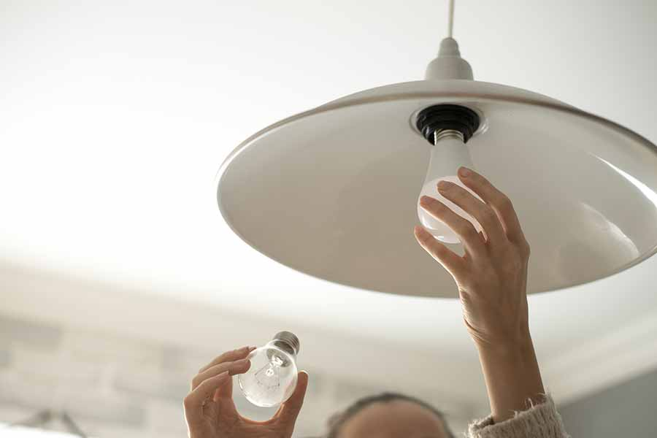
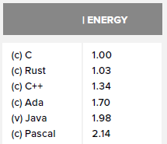
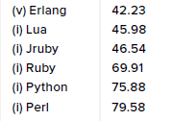
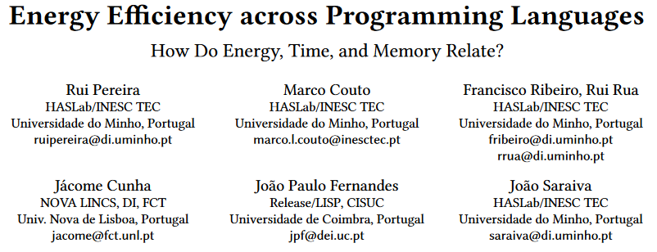
Utilize an Efficient Technology
“Switch the 20 W halogen bulb to a 4 W LED bulb”
Use Efficient Languages and Tools
  (This 2017 study used
  rather unrealistic
  benchmark
  programs)
    Mandelbrot???
Own experiment of a 3 endpoint REST Service impl:
Java (baseline)
Go (-3.5% energy)
Scala (+27% energy)
Python (+162%, 2½x)
Notes:
Source: https://greenlab.di.uminho.pt/wp-content/uploads/2017/10/sleFinal.pdf
C is the baseline language (=1) in energy consumption.

Slide 27
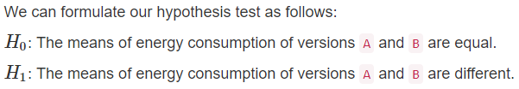
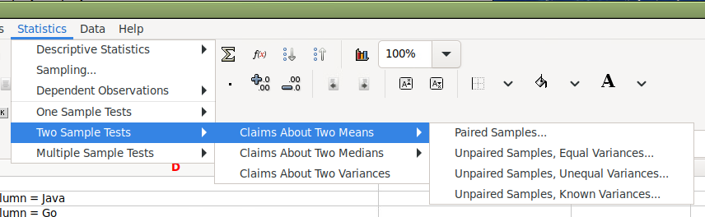
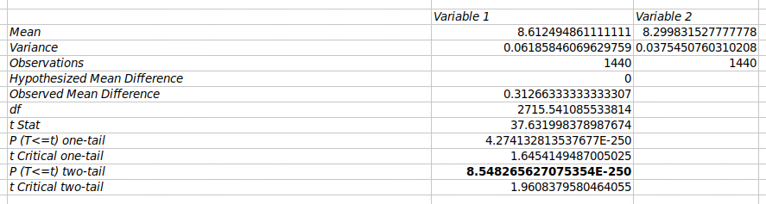
[SideBar]
Statistics is rather essential here
  Thanks to Markus from Statistics and all his predecessors ☺
Question
  Is Go really 3.5% more efficient or is
  it due to statistical uncertainty?
Answer
Do a Welch T-test
  Using Gnumeric
  p-value < 5% ☺
Own experiment of a 3 endpoint REST Service impl:
Java (baseline)
Go (-3.5% energy)
Scala (+27% energy)
Python (+162%, 2½x)

Slide 28
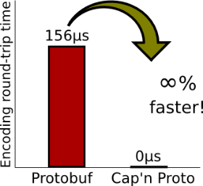
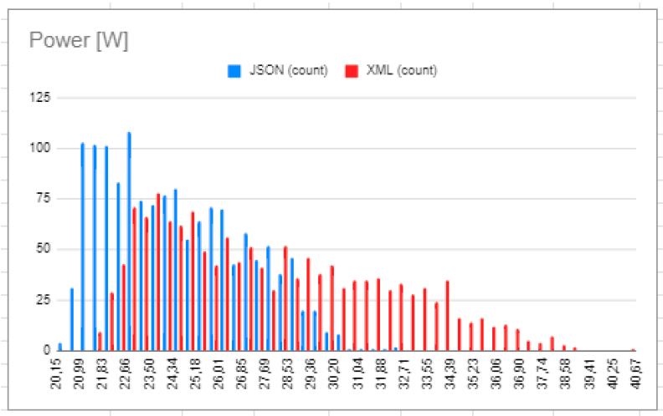
Utilize an Efficient Technology
“Switch the 20 W halogen bulb to a 4 W LED bulb”
Use Low-footprint Data Formats
    XML is much more verbose than JSON
    Binary formats: ProtoBuf, Cap’n Proto
  Part-time students did a XML versus JSON experiment
JSON: 24.5W (σ 2.5w)
XML: 27.9W (σ 4.1W)
That is 12.2% saved energy by
using JSON over XML
Notes:
Meta: Group Delta/F2023/Mandatory 6. TeleMed storage load scenario.

Slide 29
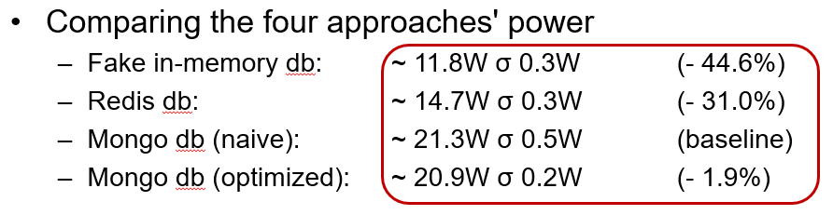
Utilize an Efficient Technology
“Switch the 20 W halogen bulb to a 4 W LED bulb”
Use Efficient Databases
    If only a ‘blob storage’ / key-value store is
    necessary then pick one, rather than a SQL or
    a MongoDB database
  Example
    REST service (three endpoints: One POST and two GET)

Slide 30
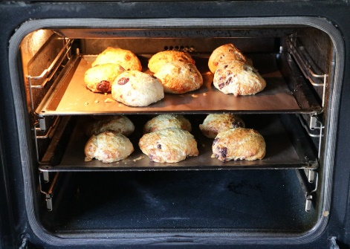
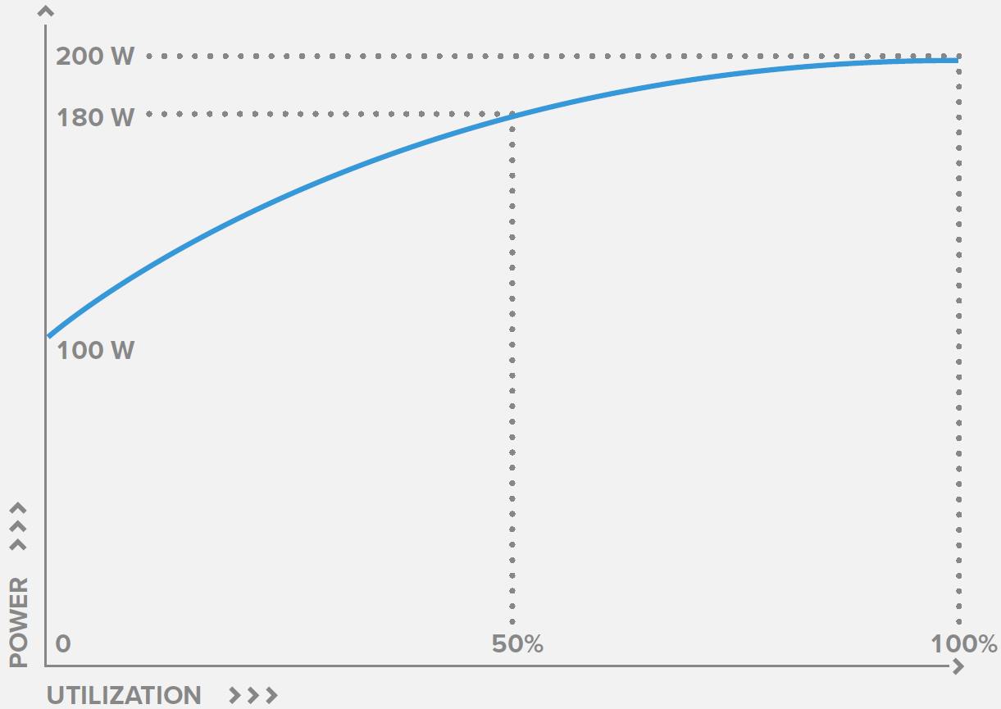
Utilize your Resources Efficiently
“Prepare several items in the oven at the same time”
An idling computer spends between
1/4 - 2/3 power compared to a busy
computer
    The non-proportionality of energy consumption
Which means:
  Per-transaction energy cost is
  lowering as the computer is
  more heavily utilized

Slide 31
Utilize your Resources Efficiently
“Prepare several items in the oven at the same time”
Imagine a single server
  Handling 2.000 tps at 100% CPU load
    Result: 2.000 tps spending 90 W
90W

Slide 32
Utilize your Resources Efficiently
“Prepare several items in the oven at the same time”
Change to Horizontal Scaling: Two servers
  Handling 1.000 tps each at 50% CPU load
    Result: 2.000 tps spending 2 x 75 W = 150 W
Morale: Make your CPU do as much work as possible!
90 W versus 150 W
75W
1.6x energy!
And a surplus energy consumption by the load balancer…

Slide 33
Utilize your Resources Efficiently
“Prepare several items in the oven at the same time”
Pool Physical Machines (Cloud)
    Host a lot of VM on same physical machine means
    when A is not using the CPU, then B have it
      Cloud centers are better at that than on-premise
Pool Resources (Threads/Connections)
  Threads and connections are expensive to create and deallocate
    Pool them
Own experiment: Three-tier system with MariaDB storage. A) Naïve ‘connection-pr-request’ connector; B) C3P0 ‘pool’.
Pooled connection spent about 62.5% less energy.
Naïve: 192tps
C3P0: 514 tps
Disclaimer: Naïve had coarse-grained locks applied…
Notes:
Re the note: The Naïve variant could not cope with the load, and threw SQLExceptions, which lead to the conclusion of race conditions. I put ‘synchronized’ on all connector methods, which is rather brute force. It worked, but the TPS is probably lower than could be achieved by a more detailed study…

Slide 34

Accept Lower Fidelity
“Turn the room temperature down from 21° to 19°”
Replace Dynamic Contents with Batch
    Change webpage dynamic content (expensive)
    with batch once-per-hour (or per-day) computation
    of a static webpage (cheap)
Lower Fidelity of Video/Images
    Use 720p instead of 1080p (halves the size)
    Downscale images server side
      Use JPEG rather than GIF/PNG

Slide 35
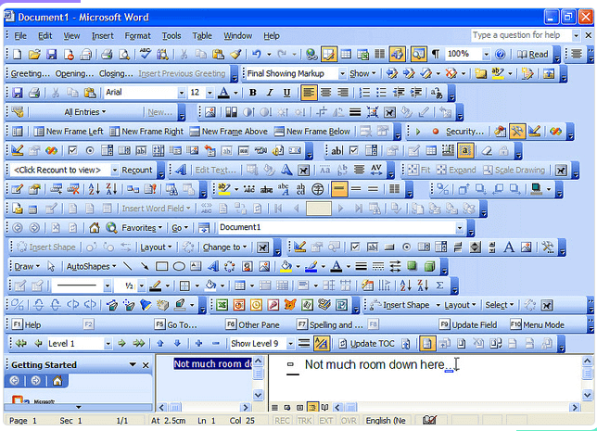
Accept Lower Fidelity
“Turn the room temperature down from 21° to 19°”
Avoid Feature Creep
  Do we really need it all???
Maybe it is about time, we start taking out features, instead of just adding more!
Light editions with Green Label.
Notes:
WarStory: Kommunal IT indkøbschef i khb området: Vi har lige købt system X udelukkende fordi det kunne mere end konkurrenterne!

Slide 36
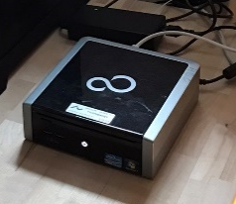
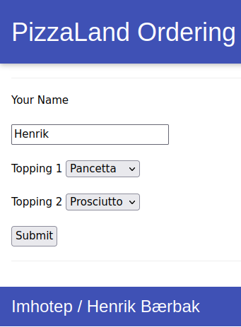
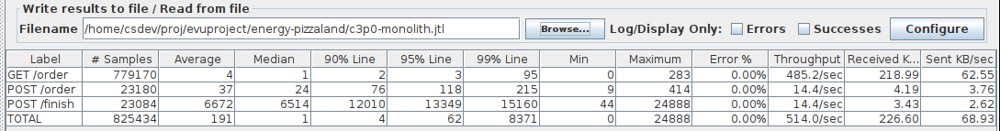
Accept Lower Fidelity
Avoid Feature Creep
‘PizzaLand’ Experiment:
A ‘core’ REST based pizza ordering system with ordering and inventory system in MariaDB; deployed on a 2012 i5 CPU @ 2.5GHz/4 core + 8GB DDR3 RAM
Handles 51,800 orders per hour!

Slide 37
And another Category…
… which is not really about software…

Slide 38
Do Not Buy New Stuff
Potential Addition to Green Architecture Framework
  Keep the old machines running
    More of a hardware tactic but…
  Laptop running 8h a day for 4 years
    Daily computations 61.5 kg CO2eq
    Production and Shipping 361 kg CO2eq
  Thus around 75-85% of total emissions is manufacturing!
https://circularcomputing.com/news/carbon-footprint-laptop/
Notes:
Embodied emissions (due to hardware production of new computer after you replace the old one): For consumer laptops, embodied emissions make up 75-85% of total emissions, and the general pattern is the same for servers. (https://www.gustavwengel.dk/greener-cloud-computing)

Slide 39
Summary and Discussion

Slide 40

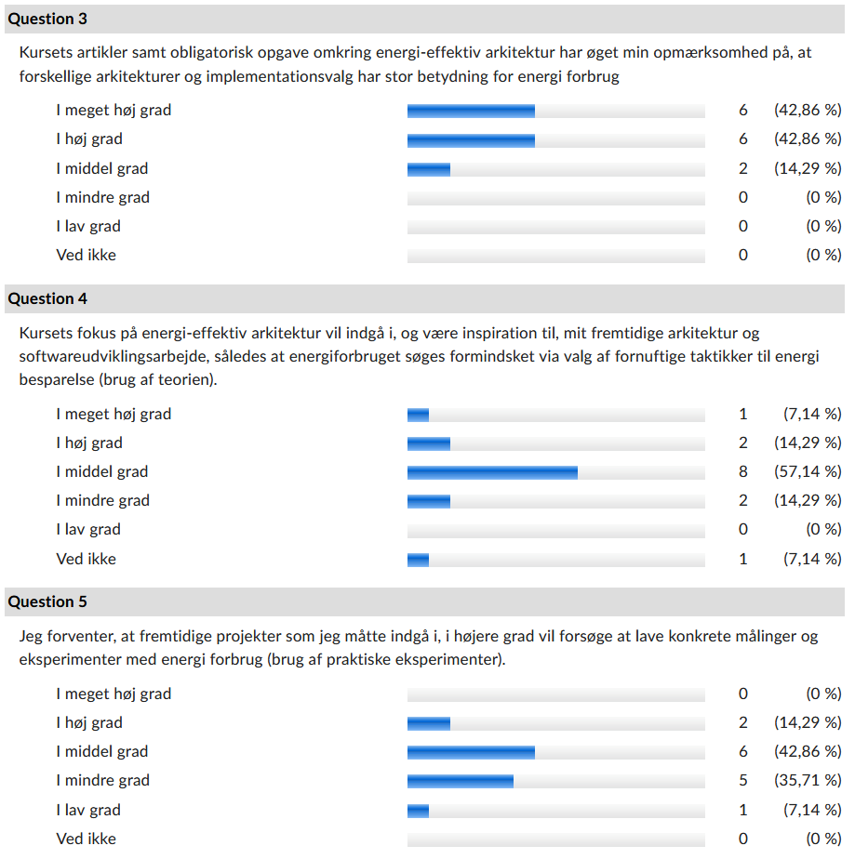
Summary
Questionnaire to part-time students

Slide 41
Summary
However, they all require an
investment…
  More complex code
  Experiments are time consuming!
Low Hanging Fruits (?)
    Get utilization of CPUs up to ~75%
    Low-footprint data formats
    Bulk fetch data + Caching
    Keep your old machines running

Slide 42
Discussion
Many of my colleagues have a rather narrow focus
  They are scientist digging deep
  into the subject matter
    All fine, but …
    … what about
    all the other important stuff?

